Slide 1
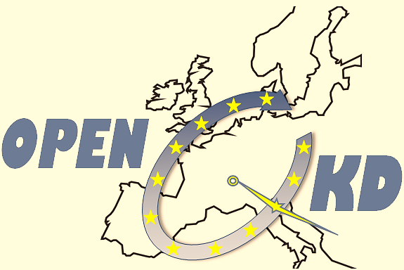



Open European Quantum Key Distribution Testbed
QCrypt 2020: online conference
Industry Session, 12th of August 2020
Andreas Poppe
AIT Austrian Institute of Technology (project coordinator)
This project has received funding from the European Union‘s Horizon 2020 research and innovation programme under grant agreement No 857156.

Slide 2
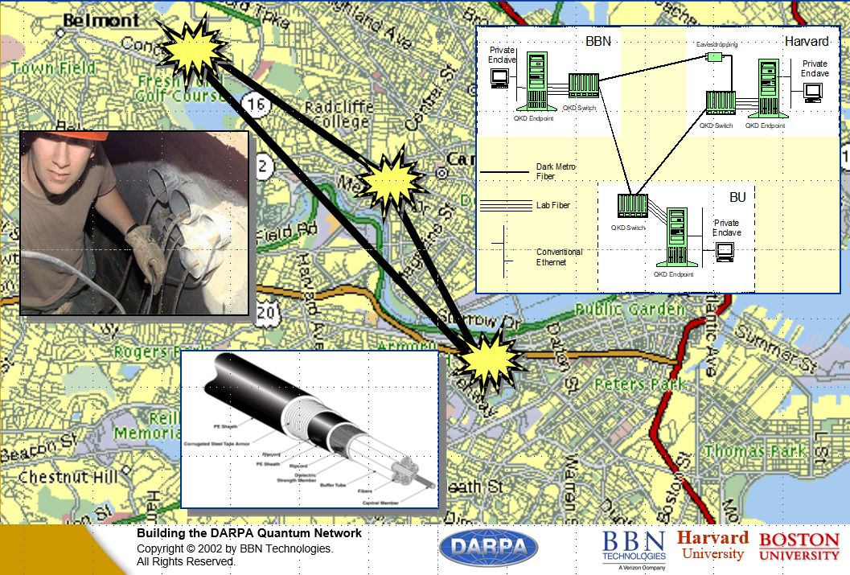
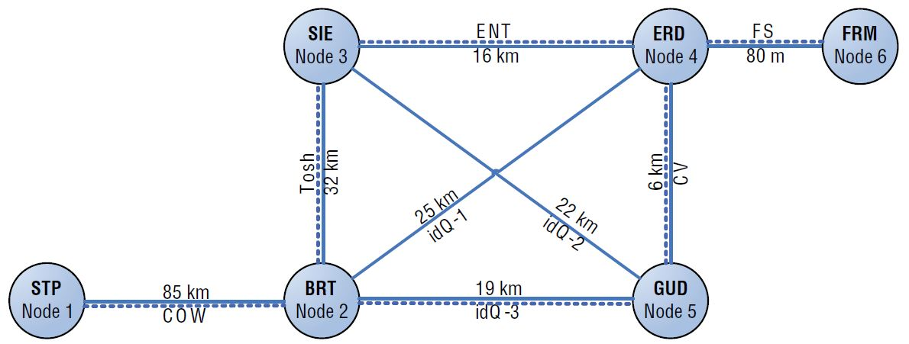
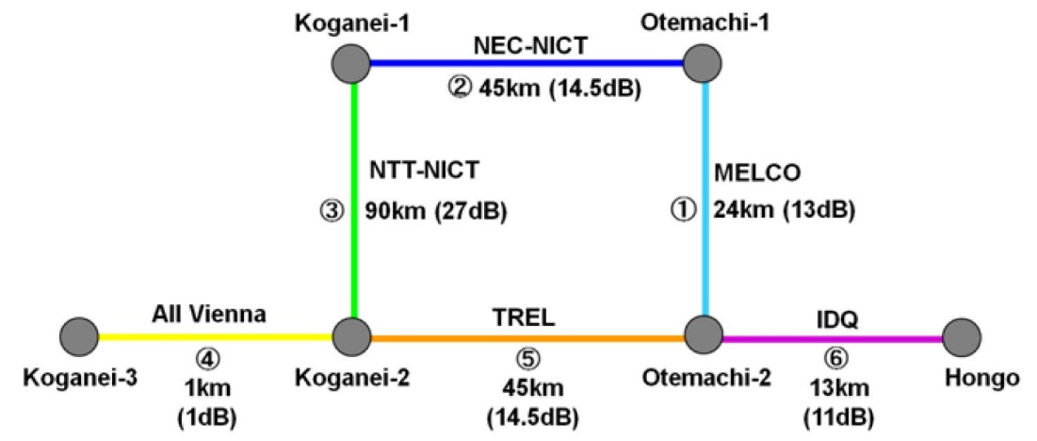
History of QKD Networks
DARPA Network 2002
SECOQC Network 2008
Tokyo Network 2010
Chip Elliott, NJP 4, 46 (2002)
M. Peev et al., NJP 11, 75001 (2009)
M. Sasaki et al., Opt Exp. 19, 143962 (2011)
All these demonstrations show interoperability of QKD-links from different vendors. Unfortunately they all failed to trigger attention from telecoms to start (massive) deployment, because the functionalities demonstrated there (switching, trusted repeaters) could not be mapped to deployed infrastructures.

Slide 3
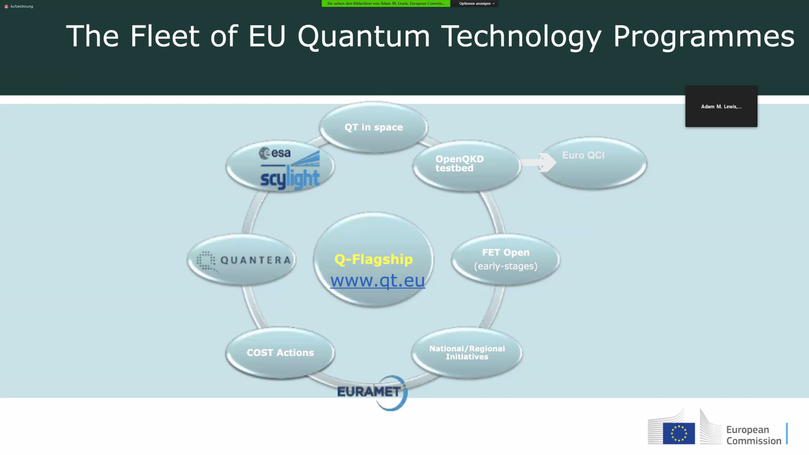
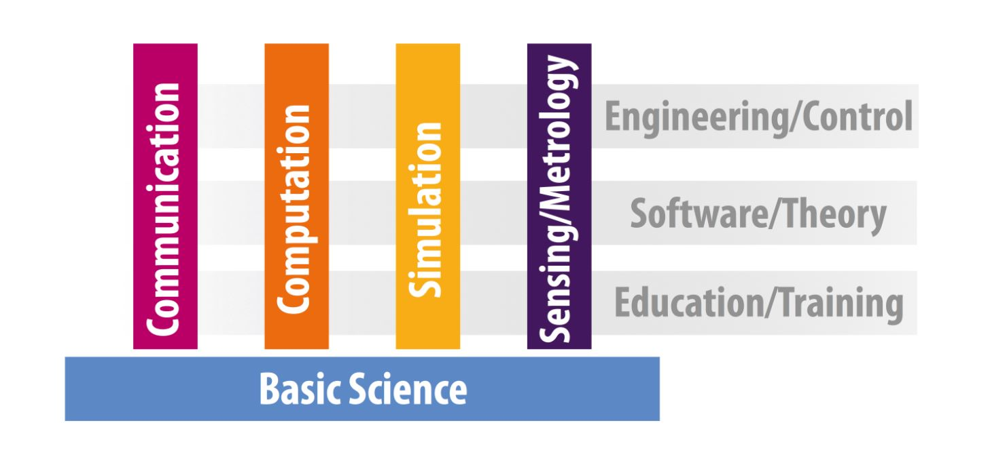


Slide 4
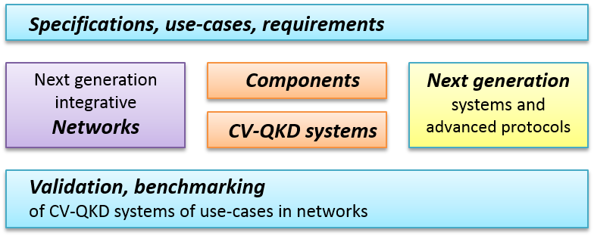
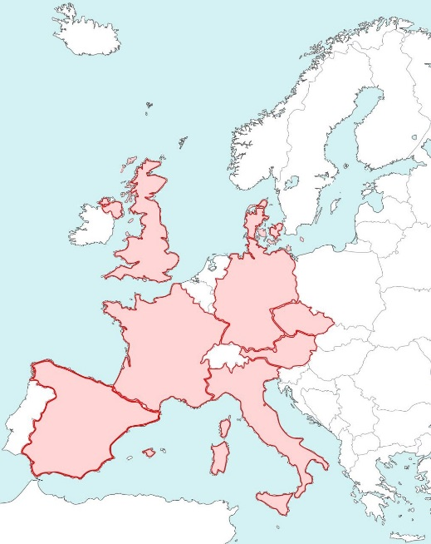
EU QT-Flagship project CiViQ
For further industrialization, the EU wide CV-QKD community grouped together to form a consortium with 21 partners.
Background of 21 project partners:
10 universities and research centers
8 industrial partners incl. SMEs + large enterprises
3 telecom providers
from 8 EU-countries and Israel:
Common motivation: Transfer similarities of coherent communication schemes to the quantum domain.
The goal is to open a radically novel avenue towards flexible and cost-effective integration of Continuous-Variable quantum communication technologies into emerging optical telecommunication networks.

Slide 5

Reference Network scenario
Management
Plane (logical)
Quantum
Plane
Data Plane
Control Plane
Realistic metro network
39 nodes
Two core sites
66 edges (max. 72.4km)
Wissel, Gunkel, Poppe “Designing a Quantum Key Distribution Network - Methodology and Challenges”, Photonic Networks; 20th ITG-Symposium, https://ieeexplore.ieee.org/abstract/document/8727121
5

Slide 6


Slide 7
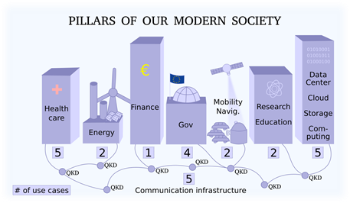
Openqkd Facts
European QKD Testbed Infrastructure: Sep. 2019 – Aug. 2022
AIT Coordinator - 38 Partner, 18 M€ (H2020)
4 Testbeds: Vienna, Madrid, Berlin, Poznan
12 National Demo sites: Paris, Delft, Cambridge, Athens, Geneva, Padua,
32 QKD use-cases + more to come: Critical infrastructure, Telekommunication, Smart Grid, Health services, Cloud Services, Inter-governmental communication, High Performance Computing, Financial Services, etc.
25 commercial QKD systems in field deployments
Free-space und simulation of satellite QKD
Open calls to attract external partners

Slide 8
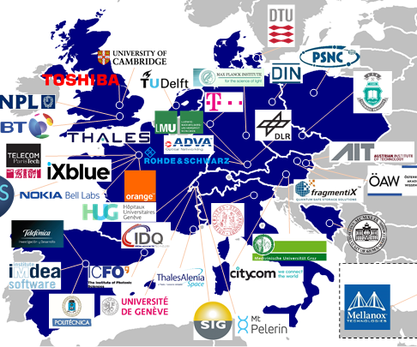
Openqkd Facts
Raise awareness for QKD
Demonstrate high maturity of technology
Cooperation with end-users
Standardisation of interfaces
Pilot for pan-European quantum communication infrastructure
Wide spectrum of partners
Telco operators
QKD developers
Suppliers of classical network equipment (encryption)
End-users
Academic groups

Slide 9
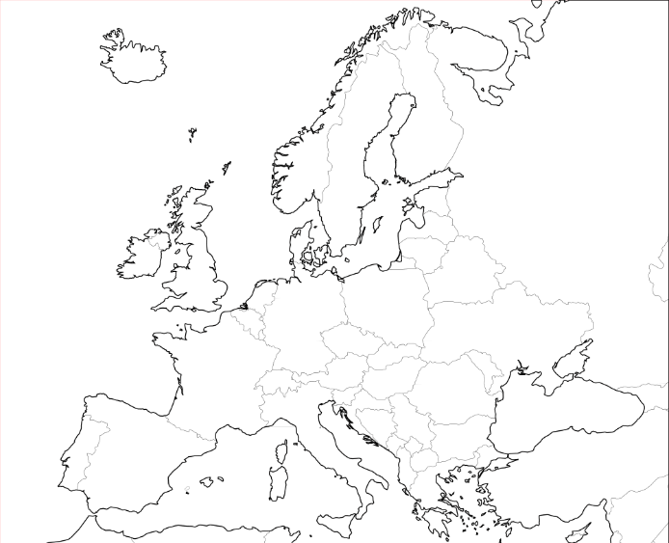
16 OPENQKD test sites
Madrid ES
Berlin DE
Posnan PL
Vienna AT
Large geographic reach-out
Governement
Telecom
Telecom
Government
Delft NL
Bratislava CZ
MDI QKD
Government
Cambridge UK
Ostrava CZ
Data Centers
High Perf. Comp.
Paris FR
Graz AT
Academic network
Healthcare
Geneva CH
Padua IT
Smart Grid
Free-space QKD
Oberpfaffenhofen DE
Matera IT
Satellite QKD
Satellite QKD
Barcelona ES
Athens GR
Video Com
Data Com

Slide 10
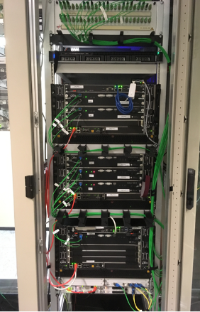

Production status
Systems
Production of 25 QKD links
Production of encryption devices (ADVA, Rohde & Schwarz, Thales)
2nd generation QKD in development
Key management (in progress)
SDN controller (in progress)

Slide 11
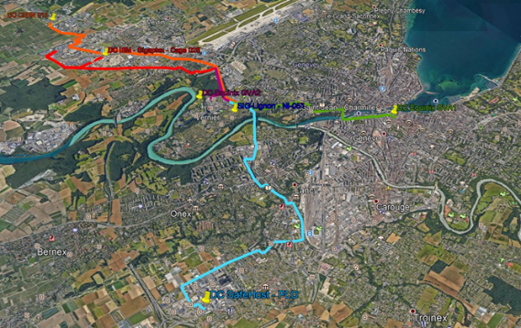
Deployment status – Geneva
Deployment started in Geneva:
6 QKD links deployed (5-10 km fiber lengths)
Use cases ready to start
Datacentre (SIG)
Quantum Vault (Mt Pelerin), point-to-multipoint
Upcoming deployments during the summer in:
Graz, Austria
Madrid, Spain
Berlin, Germany

Slide 12
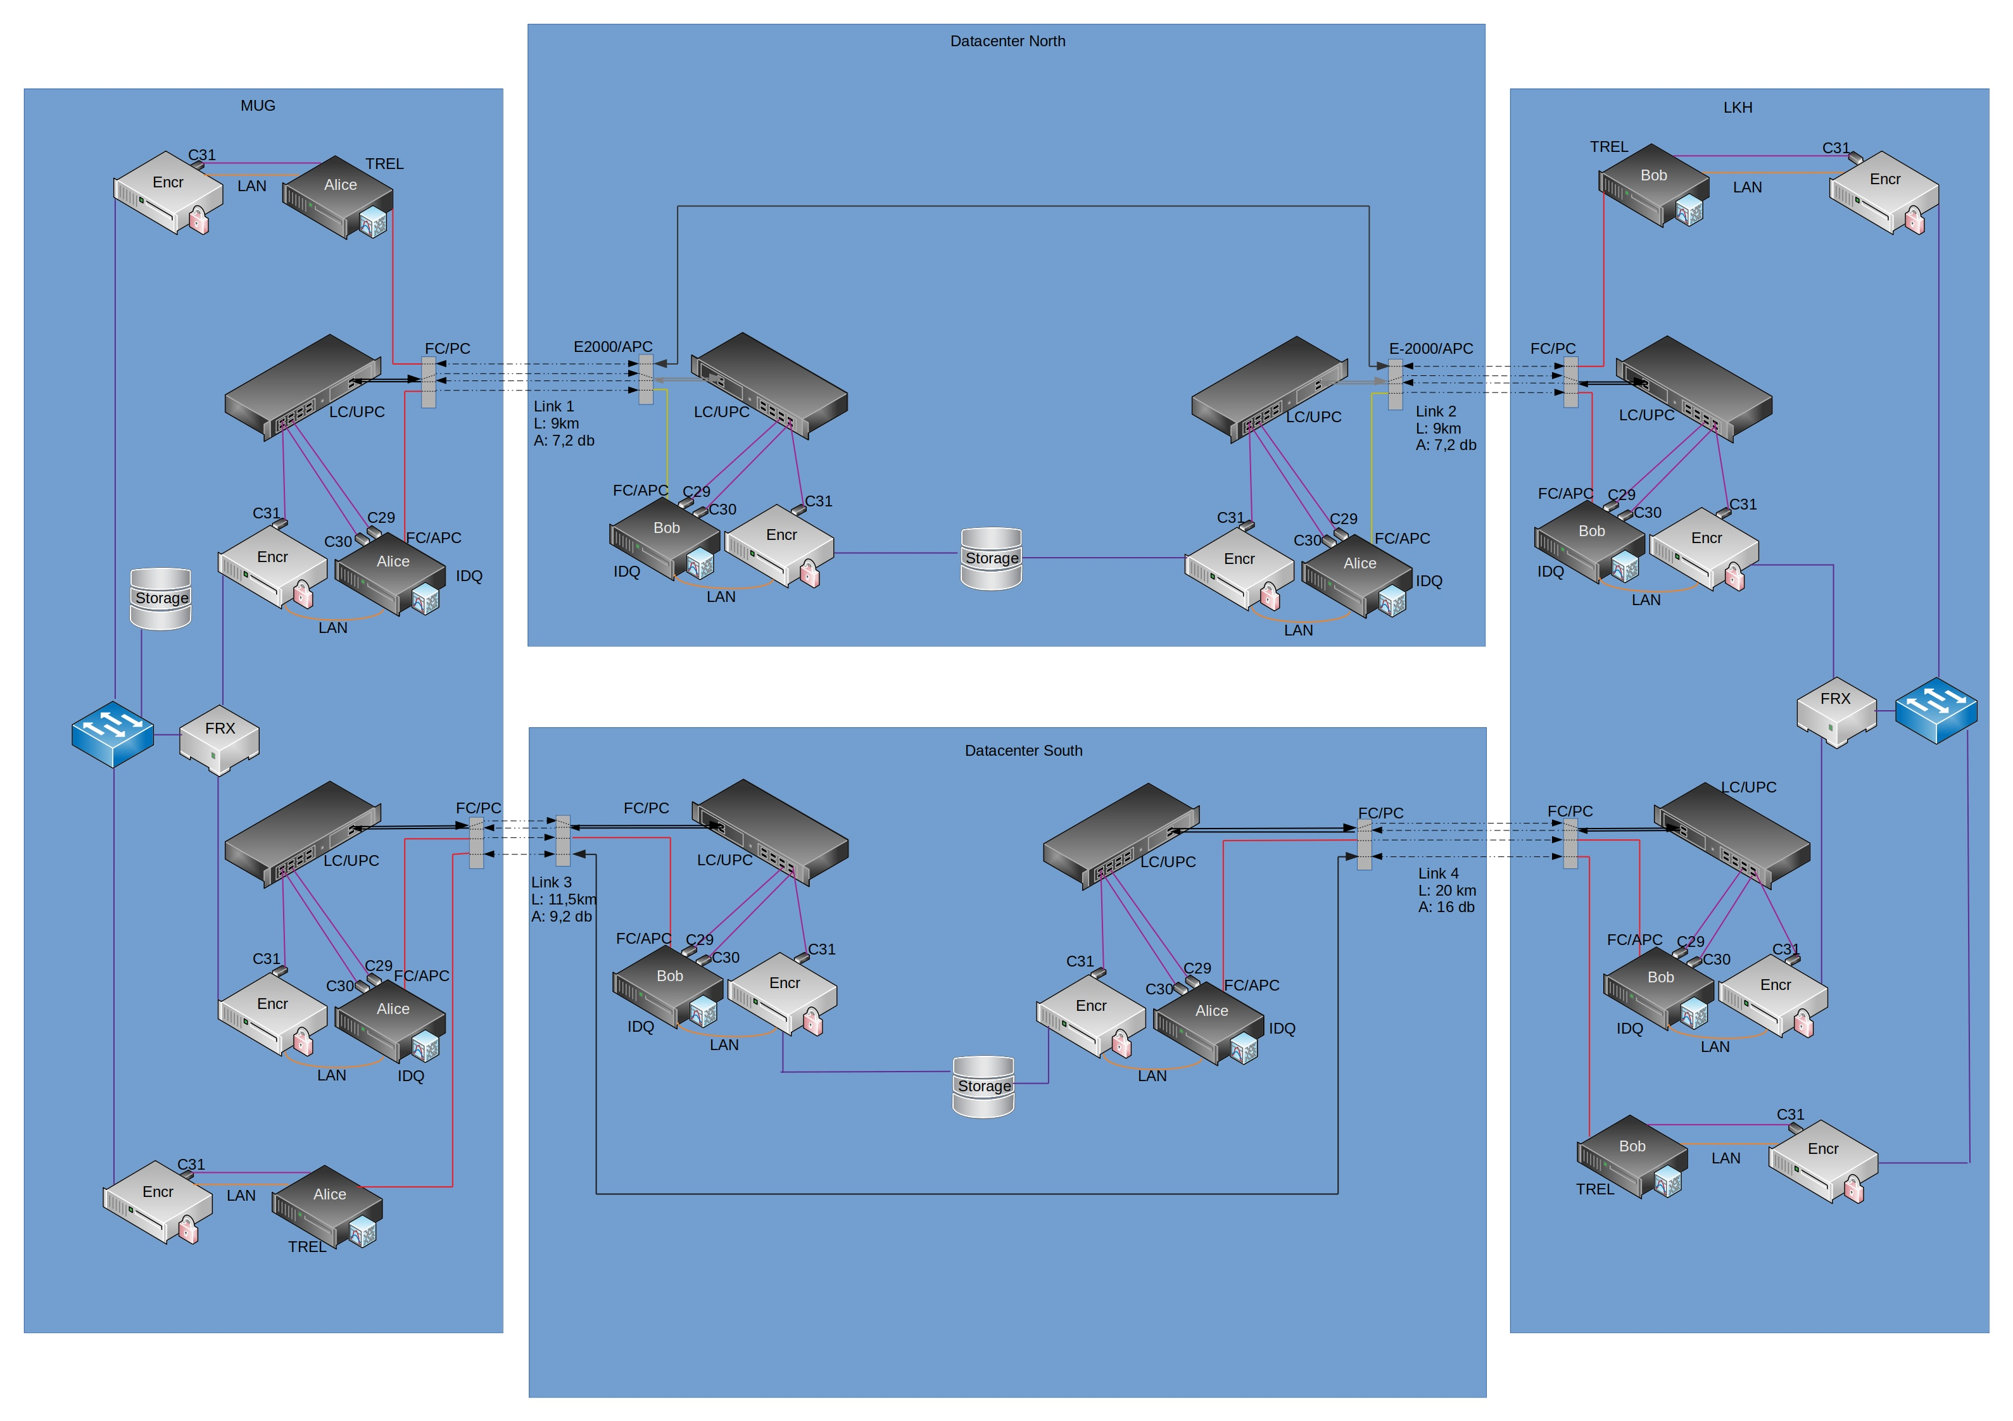







Deployment status – Graz
4 QKD links delivered
2 more QKD-links shifted due to CoViD-19
Encryptors to be delivered in 08.2020
Fibers from Citycom in Graz deployed and characterized (OTDR)
Testnetwork in the lab will be installed in 08.2020
Use-case:
High-resolution pictures of patients taken by MUC (Medical University of Graz)
Pictures (>1 TB/day) are distributed to the cloud with secret sharing technology of FRX (fragmentix)
Data will be used by the hospital LKH (Landeskrankenhaus)

Slide 13

OPENQKD Get involved
Newsletter
Open Calls
Join our newsletter to keep up with deployment and demonstration activities
Register via: alice@openqkd.eu
1.000.000 € to expand project’s innovation power
Up to 80.000€ per mini-projects
Applications, use-cases, technological development (HW & SW)
1st round in evaluation
Second round expected in spring 2021
More Information: www.openqkd.eu/getinvolved
Quantum Industry Board
Industry discussion forum
Face-to-face meetings for QIB members
More information on www.openqkd.eu
Register via: bob@openqkd.eu
Thank you very much!
Andreas Poppe AIT Austrian Institute of Technology andreas.poppe@ait.ac.at

